Slide 1

Fire Fighter Unmanned Aerial Vehicle [FFUAV]
Team Members:
KAVIN.C
SANJHIV.A
MITHUN.N.S
RIMMON.S.R
BALASUBRAMANIAN .S
ABINESH.P

Slide 2
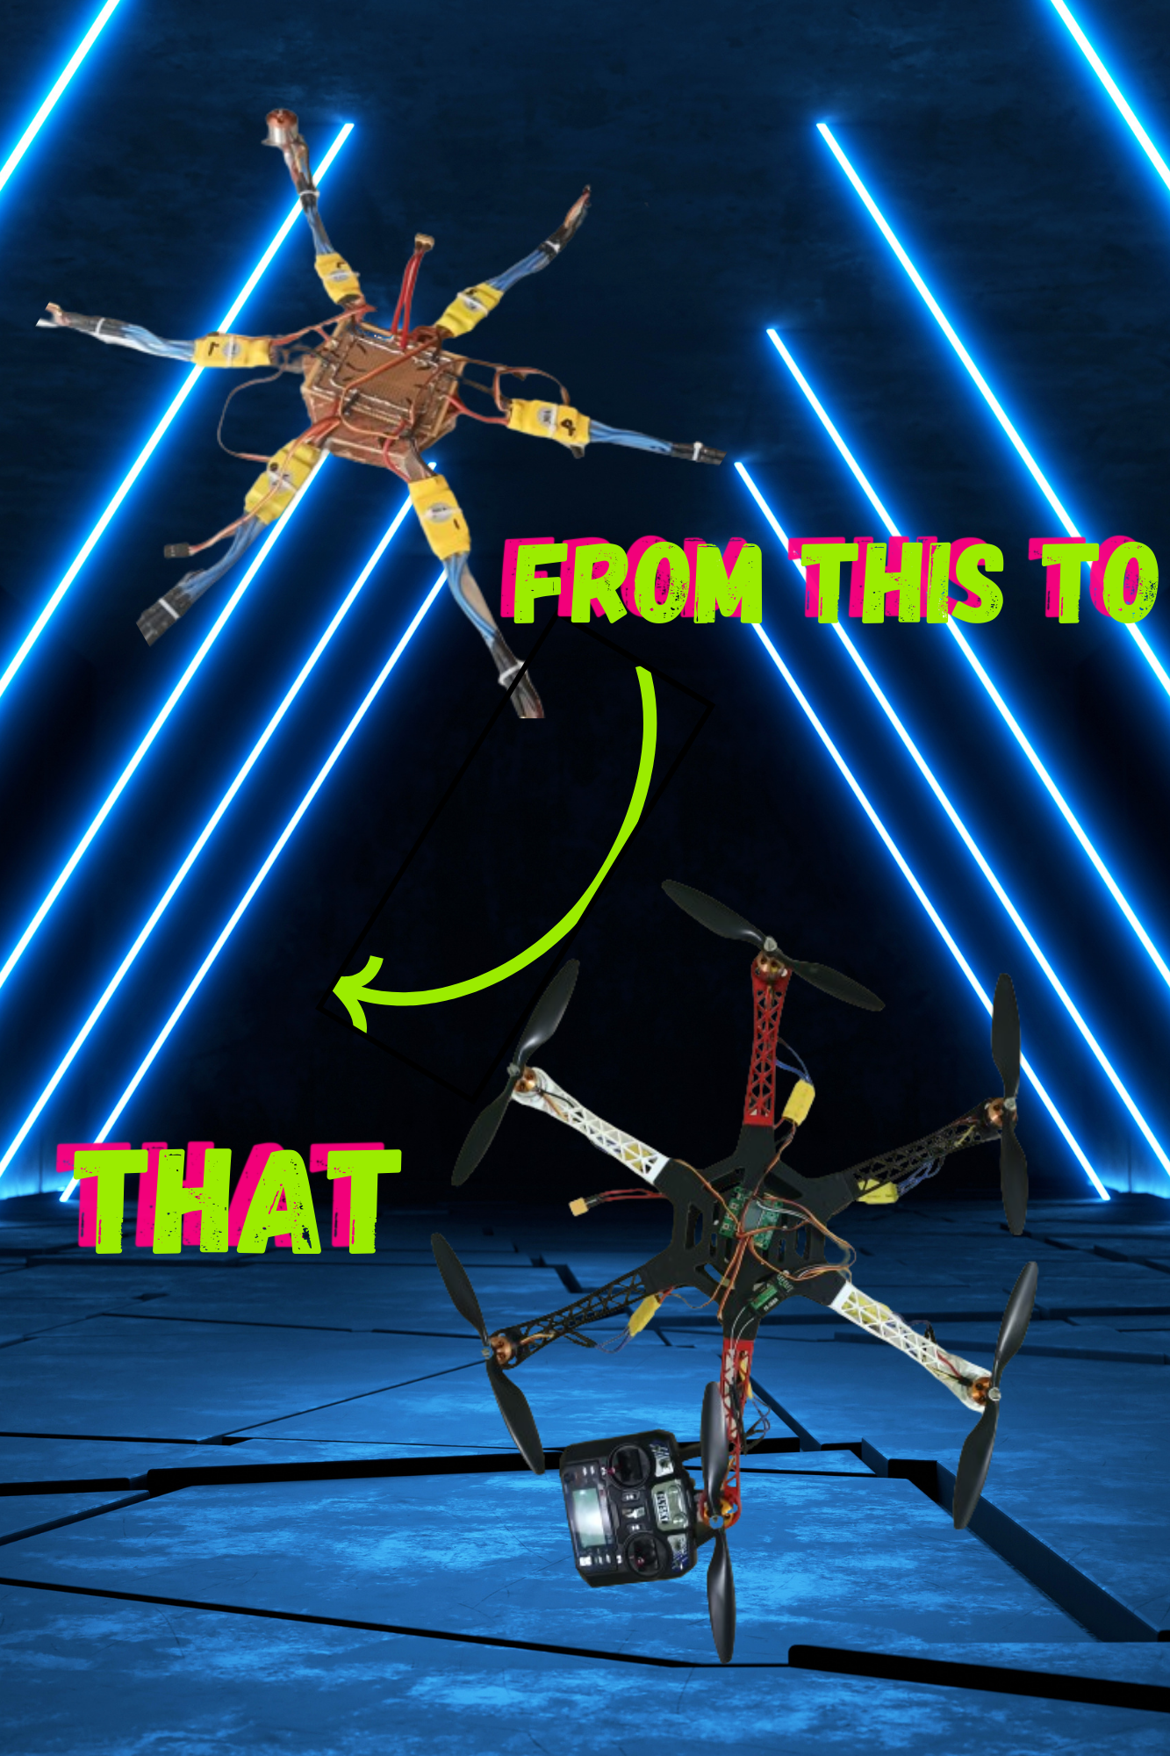
Agenda
Idea / approach
AFO
Use case
Materials required
Challenges
Final idea to make it unique
Future upgrades

Slide 3
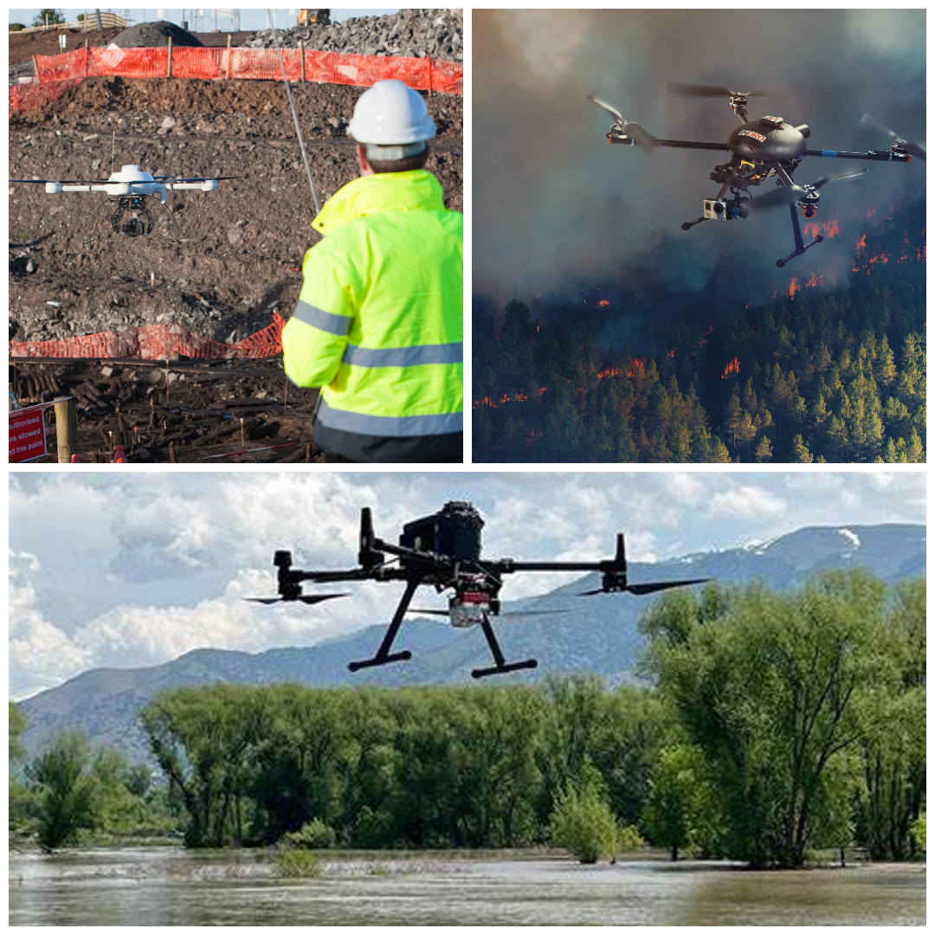
Idea / approach

Slide 4
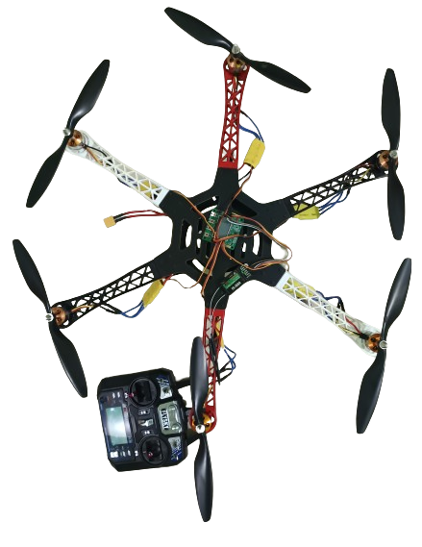
Idea / approach
Fires have lead to huge losses of life and property throughout history. Fast access to the fire and instant extinguishing is key to countering fire threats.
Here are the problems firefighters face in various situations,
Forest Wildfires: Wildfires that start in central forest areas are difficult to get to and by the time firefighters reach there with water tanks/ fire brigade vehicles the fires already spread to other areas.
Fires in high buildings: Fire fighting vehicles provide water for spraying on high building fires leading to heavy losses

Slide 5
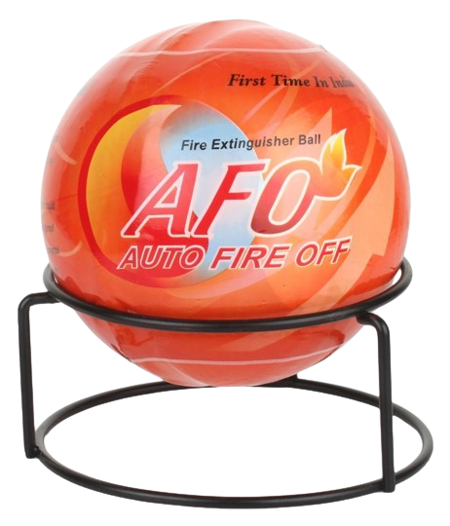
AFO

Slide 6
Auto fire off ball
Fires in homes: Fire fighters need to manually get into homes and fire emergency areas risking their lives to put out those fires.
To help in all of the above situations we here propose to design a fire fighting drone that can solve all these problems. The drone allows for easy fire extinguishing without risking life. Also it can access forest areas in an instant which would require hours for fire trucks or humans to arrive at and instantly reach high building windows with fire extinguisher.
Our drone makes use of casing PVC balls with dry chemical agents(MONO AMMONIUM PHOSPHATE) for extinguishing the fire instantly with a small blast. The system makes use of drones to deliver the fire extinguisher balls into the fire. On coming in contact with fire the balls explode with fire extinguishers to put out the fire.

Slide 7
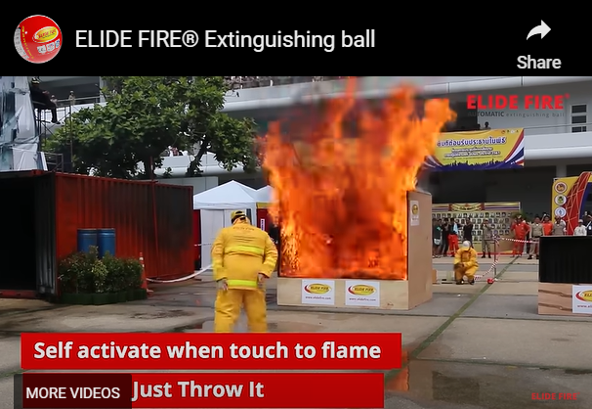
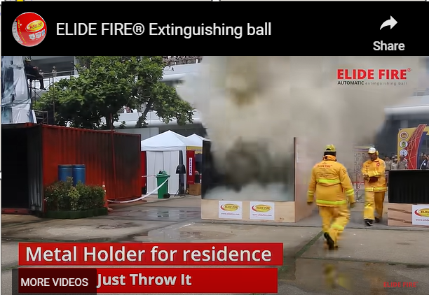
HOW IT WORKS ?

Slide 8
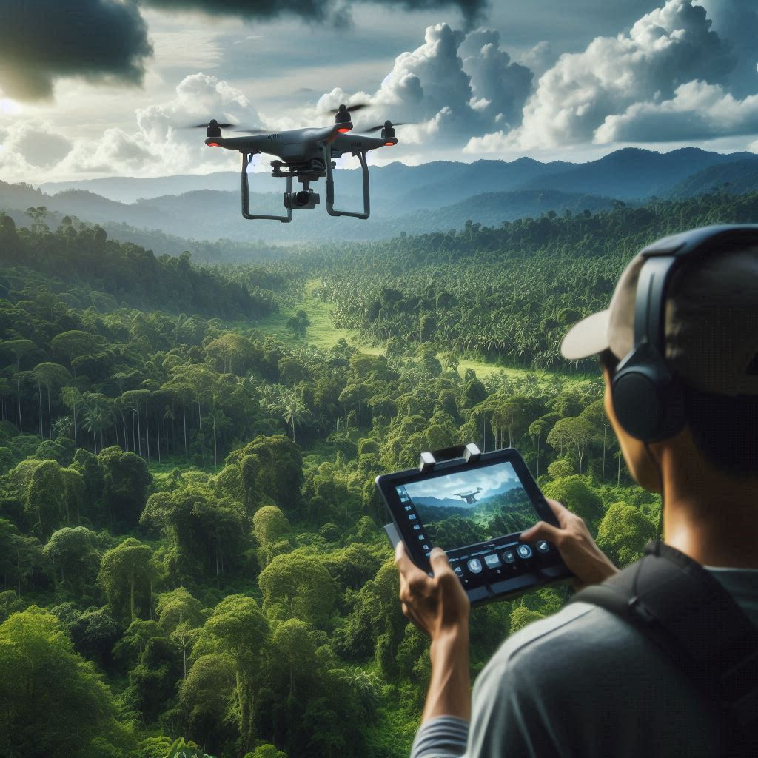
Use case

Slide 9
Timeline
User Case
Actors
Preconditions
Normal Flow | Description
Alternative Flows
Drone fire fighter
Human Being
AFO ball should be installed properly in the holder before flight and all brushless motors should be checked in proper working condition.
 | Make your drone ready for flight and install AFO (AUTO FIRE OFF)balls.
 | Make sure the signals from the transmitter reaches the receiver.
 | Reach the area or region where the fire catches and release your AFO balls
It requires a strong drone frame to carry (1-3 kg)
Make sure there is no person/animals nearby the region.
Step 1
Step 2
Step 3

Slide 10
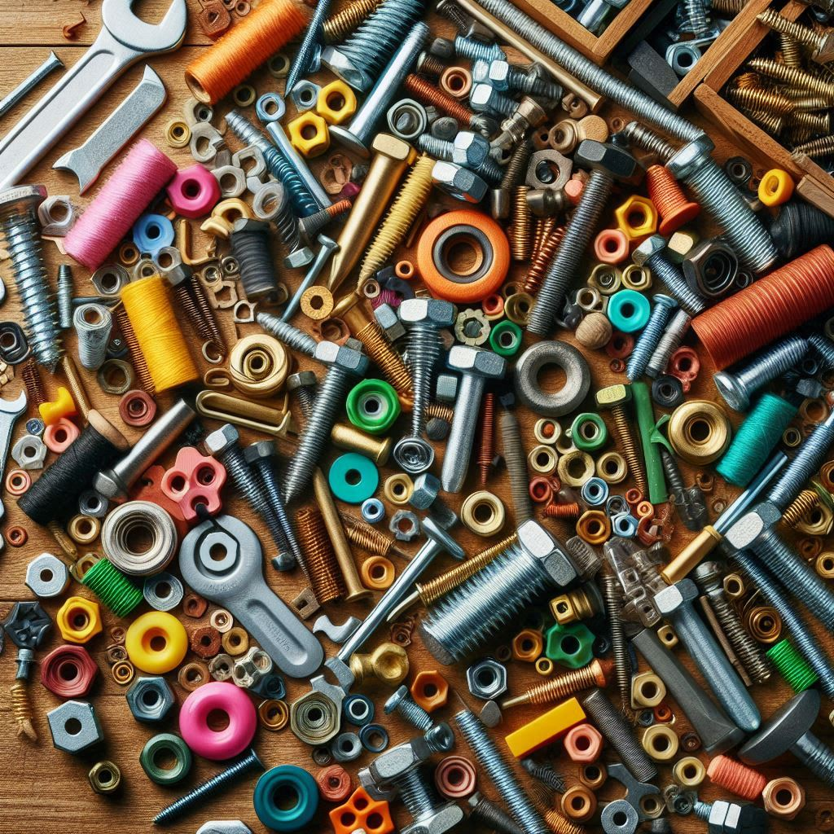
Materials Required

Slide 11
Materials Required
Brushless Motors
Drone Camera
Propellers
Servo Motor
Drone Frame
Drone Controller
Transmitter
Remote
Drone Receivers
Gripper Arms
Gripper Base Frame
Supporting Frame Fire Extinguisher Ball (AFO) Landing Gear Mounts and Joint Screws and Bolts

Slide 12

Challenges

Slide 13
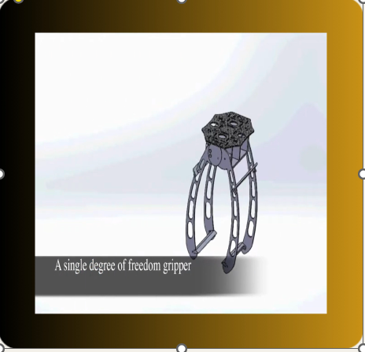
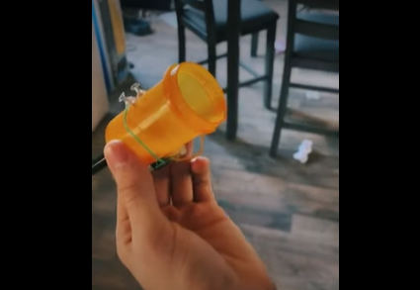
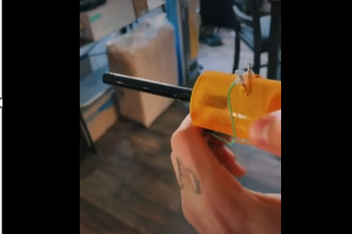
Challenges
Last idea (prediction) :
New idea :

Slide 14

Uniqueness in our idea

Slide 15
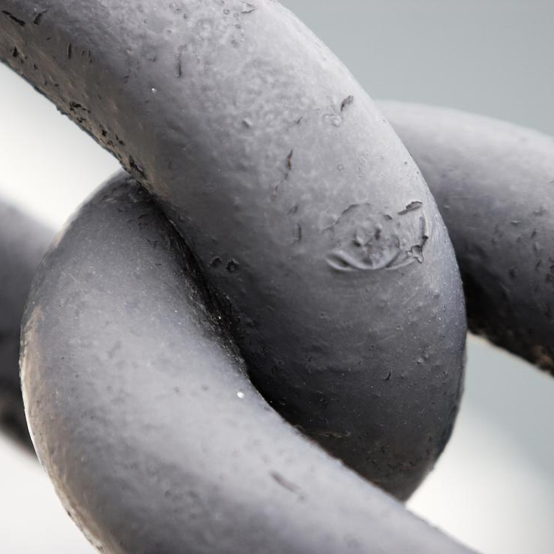
Unique research:
We are going on with the research of combining the function of gripper and also the gas shooter (multi –purpose drone), for that we requested fund of Rs./-70 – 80,000 which will be very useful for developing our project

Slide 16

Future upgrades

Slide 17
Future upgrades
We are also developing a website for our product to be known, we are yet to install camera, thermal sensor , a tracker system, ….etc

Slide 18
Thank You
We took 1 year to make it possible (i.e) to make our idea clear , if any corrections please say judicial , we take the correction as primary thing to note for development of this project. We will be in great pleasure if our project got recognized and awarded the fund ,
Thank you

